Slide 1

Including in situ visualization and analysis in PDI
2021-07-02 I Christian Witzler (c.witzler@fz-juelich.de), J. Miguel Zavala-AkE (miguelza@kth.se),
Karol Sierocinski (ksiero@man.poznan.pl), Herbert Owen (herbert.owen@bsc.es)
Founded by:
- EoCoE II, grant agreement No 824158
- CoEC, grant agreement No 952181
Notes:
My name is Chrisitan Witzler,and I am a research assistant at the Jülich Supercomputing Center with focus on in situ visualization.
EoCoE Energy oriented center of excellence
CoEC Center of excellence for combustion

Slide 2
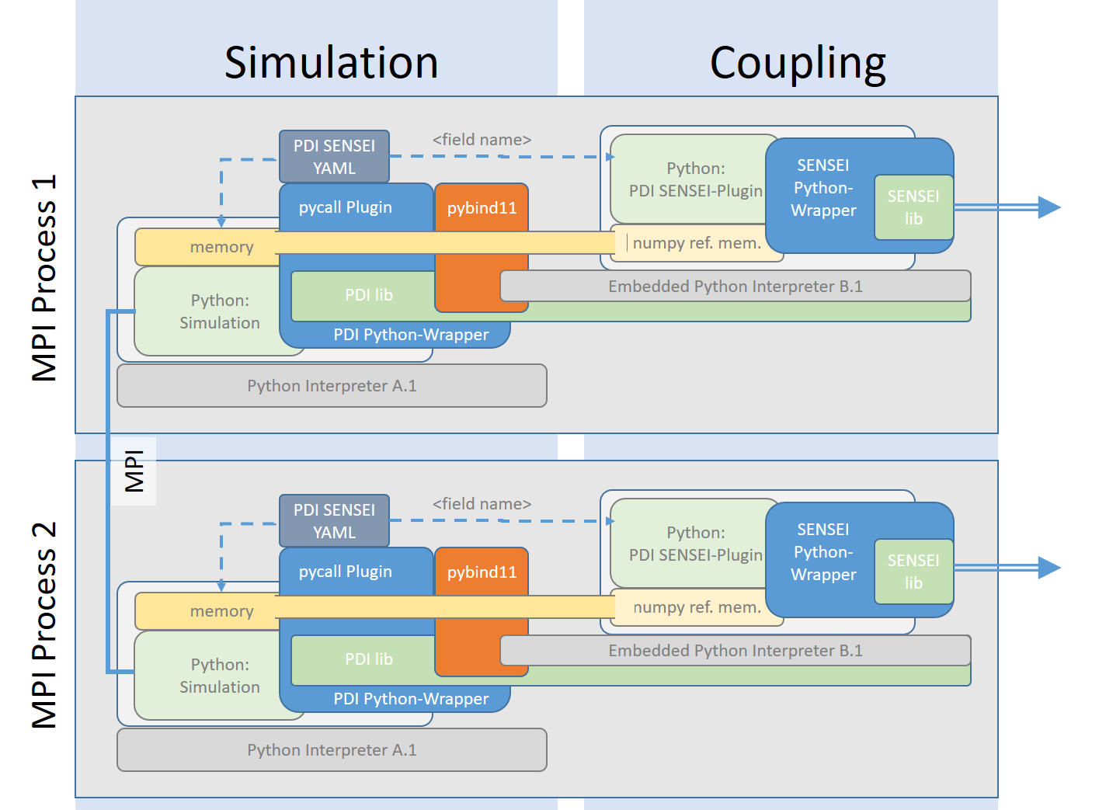
Outline
Motivation
PDI
Design decisions
Sensei
Adios2
ParaView Catalyst
Usage
PDI integration
YAML file
Catalyst
Example Bolund
Notes:
2511 nodes jeweils 12,5GB/s network
Sharing 250 GB/s to JUST => 100 MB/s/node

Slide 3
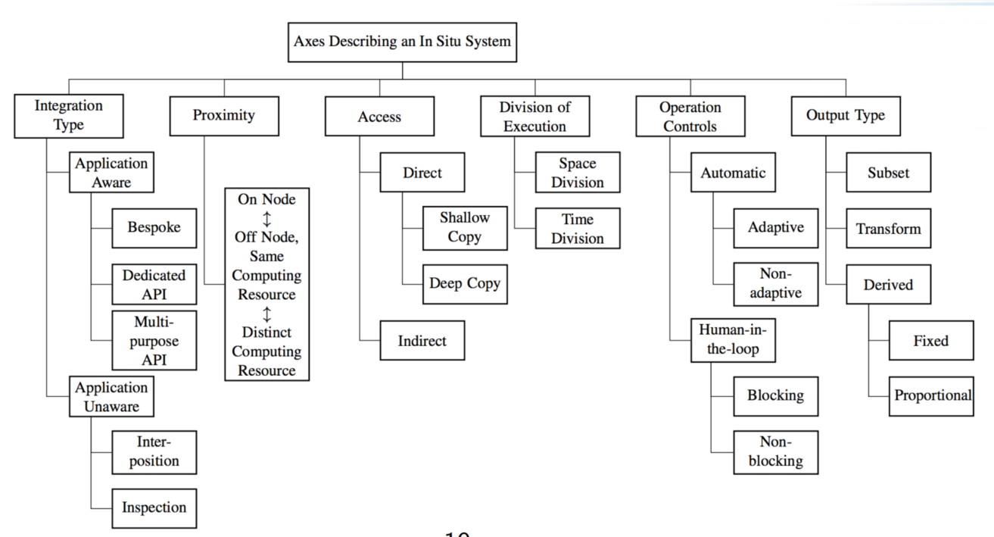
Motivation
What do we need?
Minimal dependencies for simulation code
Error resistant visualization
Minimal influence on simulation
Easy to use
https://sensei-insitu.org/tutorials/sc19.html
Notes:
Jupyter poster
https://cfp.jupytercon.com/2020/schedule/presentation/123/jupyter-for-interactive-in-situ-visualization-with-paraviewcatalyst/

Slide 4
Design
Notes:
Kommunikation

Slide 5
PDI Data Interface
Decouple I/O from HPC codes
3 parts:
PDI core
Specification tree
Plugins
https://pdi.julien-bigot.fr/1.2/
https://gitlab.maisondelasimulation.fr/pdidev/pdi
https://hal.archives-ouvertes.fr/hal-01587075
Notes:
Aims to decouple
Pdi core:
- parsing specification tree,
–loading plugins,
–managing access rights to data and memory,
–communication between simulation code and plugins (data store and eventsubsystem).
Specification tree
- data - describes the structure of shared data,
–metadata - defines data that should be copied by PDI when data is no longershared,
–plugins - defines which plugins should be loaded and configures their be-haviour
Plugins
It uses tools and libraries to make operations on data shared by simulation c
Hdf
Sionlib
fti

Slide 6
Simulation
Coupling
PDI SENSEI YAML
<field name>
Python: PDI SENSEI-Plugin
SENSEI Python- Wrapper
pycall Plugin
pybind11
SENSEIlib
memory
→ pass memory by reference →
numpy ref. mem.
MPI Process 1
Python: Simulation
PDI lib
Embedded Python Interpreter B.1
PDI Python-Wrapper
Python Interpreter A.1
MPI
PDI SENSEI YAML
<field name>
Python: PDI SENSEI-Plugin
SENSEI Python- Wrapper
pycall Plugin
pybind11
SENSEIlib
MPI Process 2
memory
→ pass memory by reference →
numpy ref. mem.
Python: Simulation
PDI lib
Embedded Python Interpreter B.1
PDI Python-Wrapper
Python Interpreter A.1
6

Slide 7
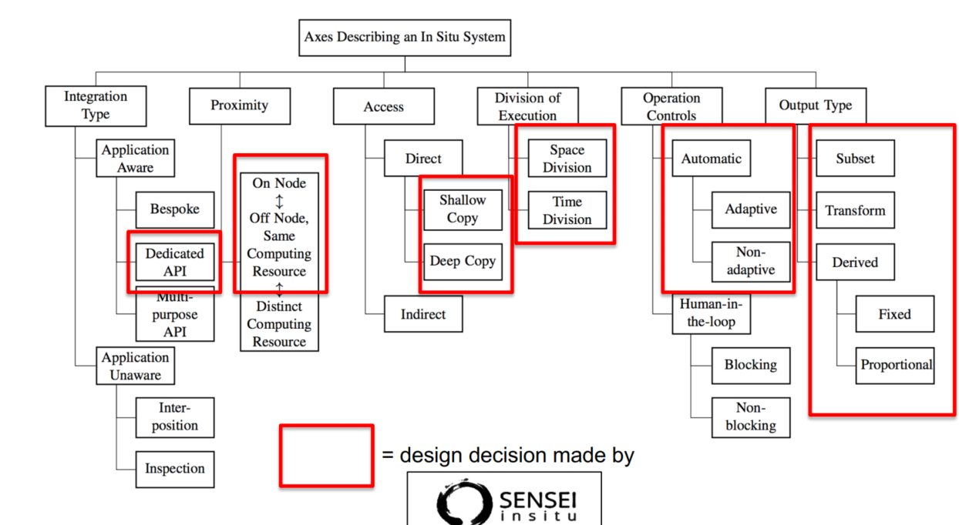
Design Decisions
SENSEI
Flexible connection to different frameworks
Adios, Catalyst, LibSim
Allows in-transit
But:
No build in data transport
https://sensei-insitu.org/tutorials/sc19.html
Notes:
Starting qith a citation
Rhinodiagnost enabled us to develop jupyter jsc
Enables use of hpc with simple login process

Slide 8
Design Decisions
ADIOS2
Using Adios2 SST for data transport
Simple to use
Scales well
Allows M2N communication
Uses RDMA
But:
Creates configuration file
Needs shared file system
M
N
Simulation
Endpoint
Simulation
Endpoint
Simulation
Simulation
Endpoint
Notes:
SST = Sustainable Staging transport
RDMA Remote direct memory access
M -> N

Slide 9
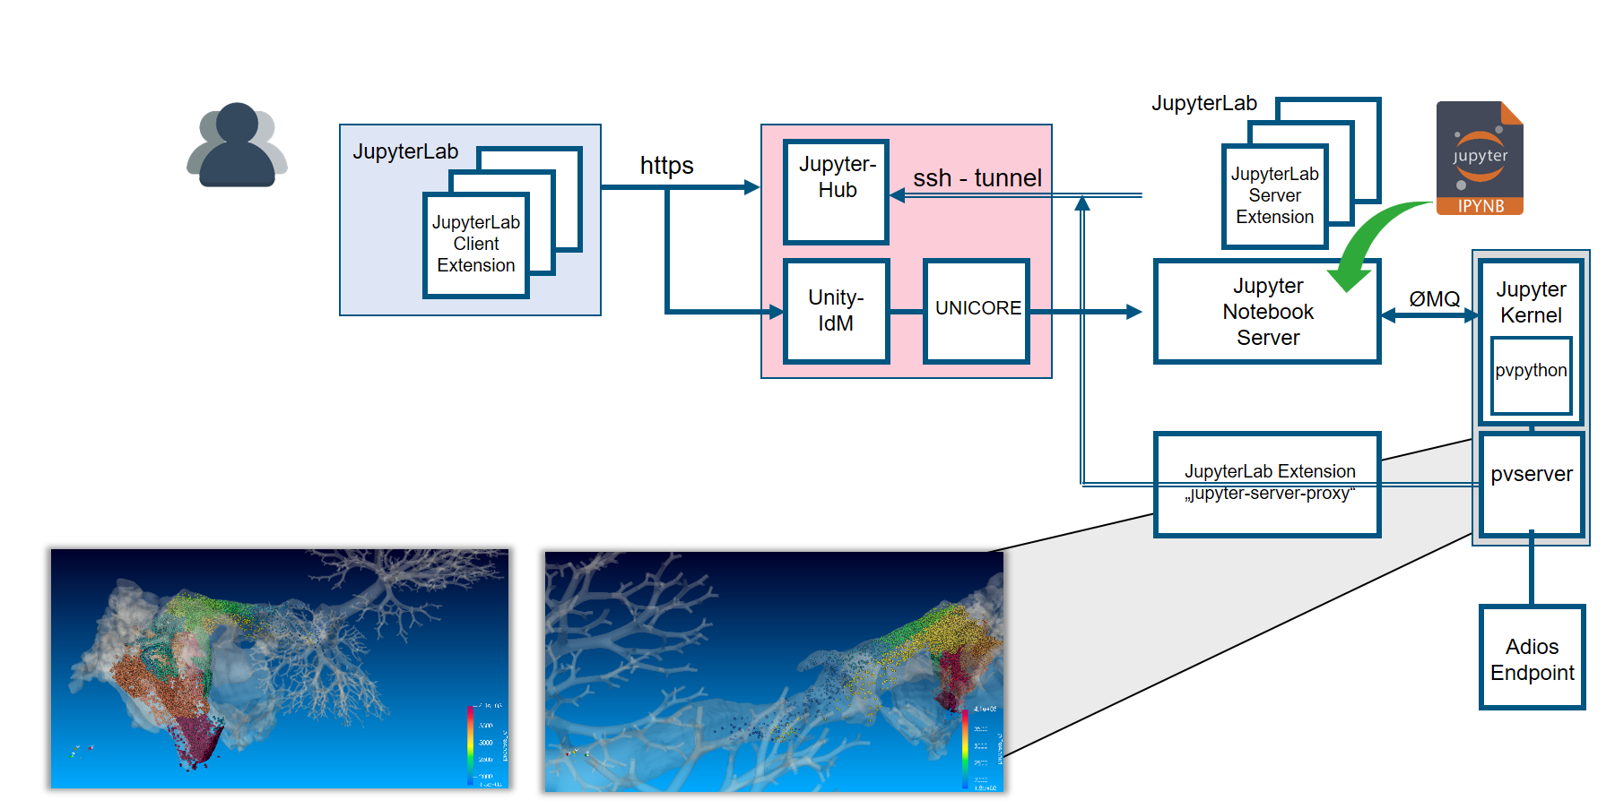
Design Decisions
ParaView Catalyst
Used for visualization
Can be run in parallel
Predefined visualization scripts
Interaktive live visualization
Is integrated in Jupyter-JSC
https://www.paraview.org/in-situ/
https://cfp.jupytercon.com/2020/schedule/presentation/123/jupyter-for-interactive-in-situ-visualization-with-paraviewcatalyst/
Notes:
Pvlink was presented to the public at JupyterCon 2020

Slide 10
Usage
Notes:
Kommunikation

Slide 11
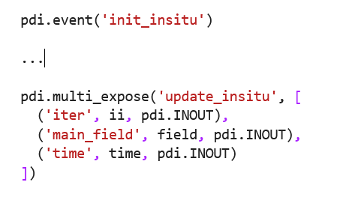
USAGE
PDI integration
PDI Events
Initialization
In-situ update
Finalization
PDI Data:
Data share/expose
Notes:
What do we have
What more do we want

Slide 12
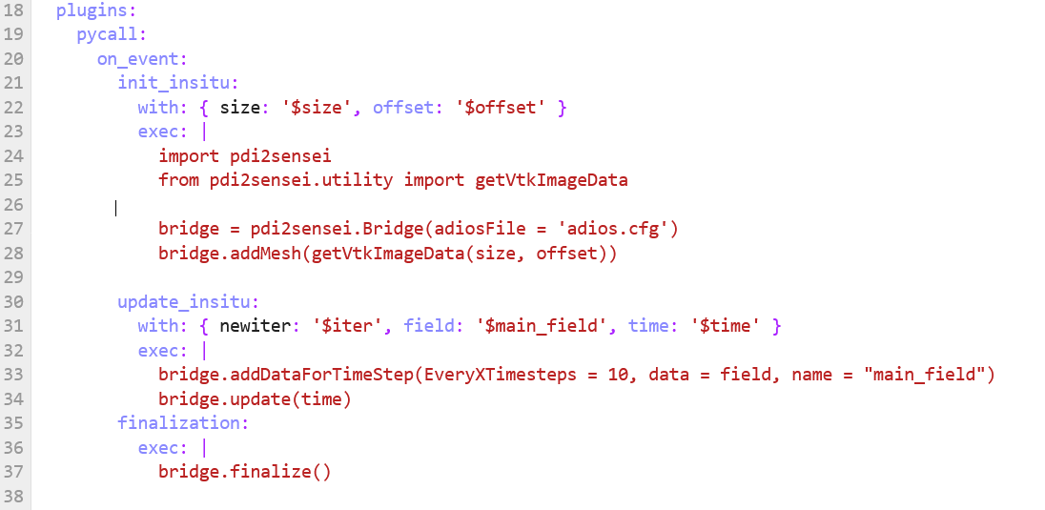
USAGE
YAML file
Connect the Events and data shares
Notes:
What do we have
What more do we want

Slide 13
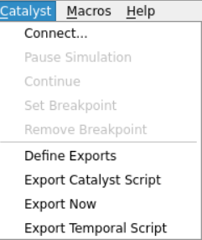
USAGE
Catalyst
Connect with a small simulation or load a sample file
Setup your visualisation pipeline
Export catalyst Script
Notes:
Small simulation with same data types avaible
Export script look for zoom to fixed coordinates

Slide 14
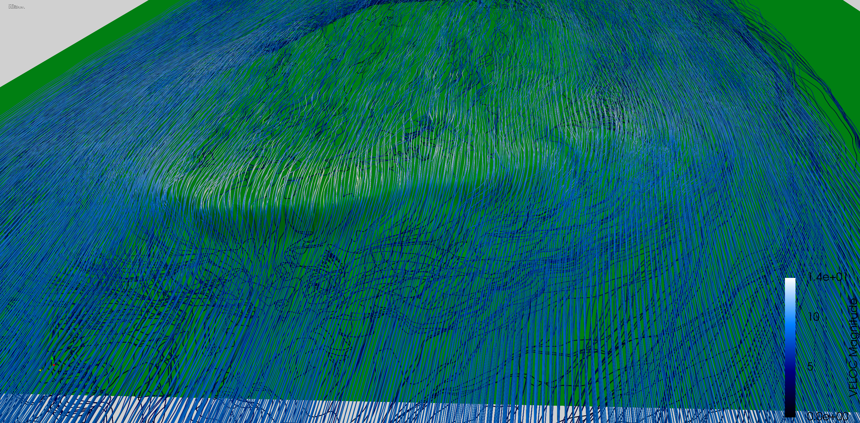
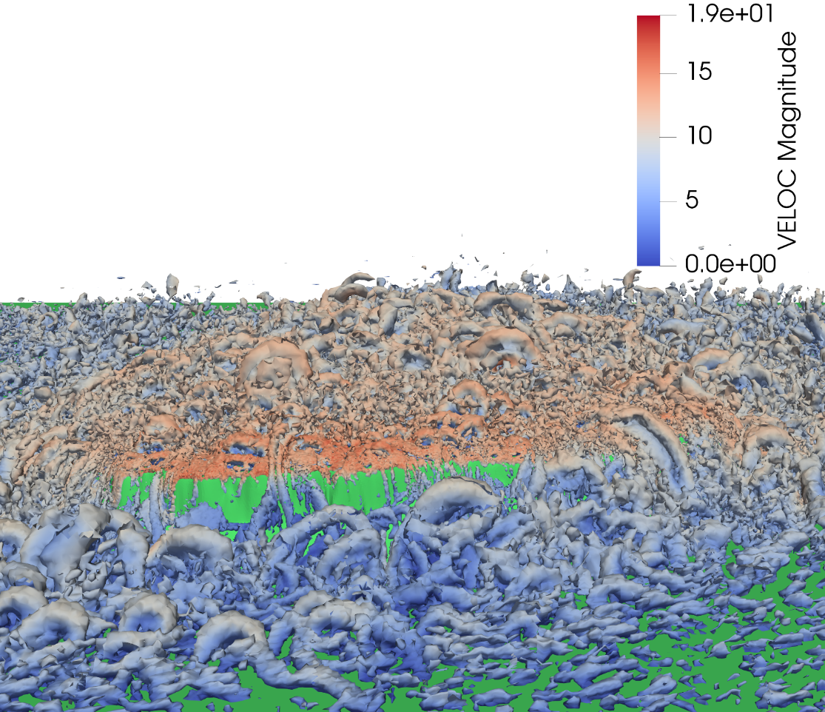
Example case: Bolund
ALYA
parallel multi-physics/multi-scale simulation code
Developed at BSC
Example case Bolund
Incrompressible flow
Large Eddy Simulation
Notes:
Bolund:
Denmark
10m heigh cliff
In the sea
The convective term is discretized using a recently proposed Galerkinfinite element (FEM) scheme, which conserves linear and angular momentum,and kinetic energy at the discrete level described

Slide 15
Summary
Minimal dependencies on simulation site
Only pdi needed
All other dependencies are indirekt
In-transit visualization
2nd (3rd) visualization job
Independent visualization
Easy configuration
YAML file
Simple functions to setup your in-transit workflow

Slide 16
Questions?
Thank you for your attention
Acknowledgments:
This work was supported by the European Council under the Horizon 2020 Project Energy oriented Center of Excellence for computing applications - EoCoE II, grant agreement No 824158 and CoEC, grant agreement No 952181
Additional thanks to the PDI-developer team as well as the ATML Vis group from JSC.

